Slide 1
The Rhetorical Situation
I can define and identify the rhetorical situation of a text and/or speech.

Slide 2
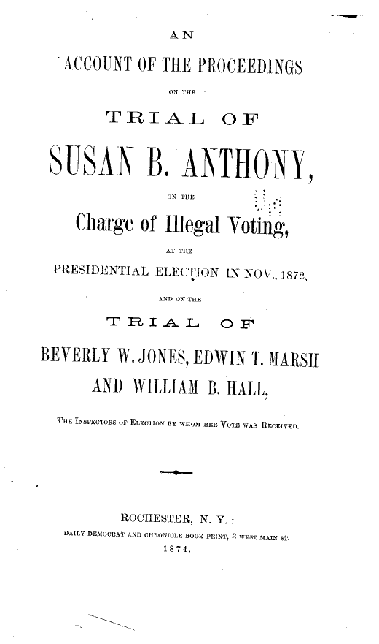
Elements of the Rhetorical Situation
Exigence- this is the event, problem, or situation that motivates a person to speak or write on a topic. The term is derived from the latin word for “To Demand,” expeto. (It is what gets some fired up and feeling like they must do something about it!)
Example:
Susan B. Anthony was arrested for attempting to vote, which motivated her to do something about it.

Slide 3
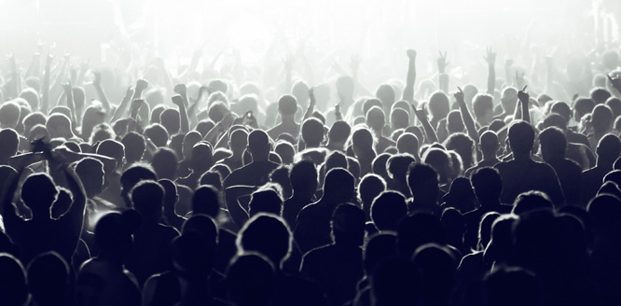
Elements of the Rhetorical Situation
Audience- who the speaker is crafting their message for. An audience could be narrow, one specific group, or it could be broad to include several groups.
Example:
Susan B. Anthony obvious spoke to women when she says, “aren’t we persons too.” But, it is more likely that she was speaking to a broader audience that included older, white males, who had the power to change this particular law.

Slide 4

Elements of the Rhetorical Situation
Purpose- This is what the speaker attempts to get their audience to do. Whether it be to change their opinions or ACT upon their feelings, the purpose can only be achieved if the message is crafted FOR the audience. (Inform, Entertain, Persuade)
Example:
Susan B. Anthony has different purposes for her broad audience. Women most likely support her, so she will want to persuade them to DO something. Whereas her intentions for her male audience would have been to CHANGE their opinions.

Slide 5
Elements of the Rhetorical Situation
Message- The information being given. The message MUST be crafted to appeal to the target audience and the target audience determines the medium of the message (medium- format of the message).
Example:
Susan B. Anthony’s message was about women’s suffrage and why women have the right to vote just as much as men do.

Slide 6
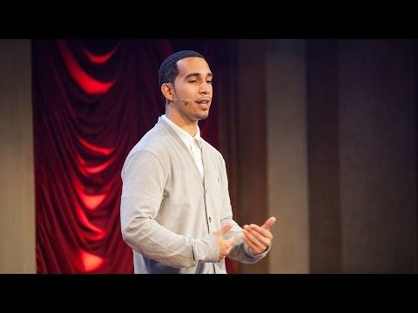
Practice:
Watch the TED Talk by Ismael Nazario, “What I learned as a Kid in Jail,” in order to identify the rhetorical situation.
Exigence- What motivated this speech?
Audience- Who is he speaking to?
Purpose- What does he want from audience?
Message- What is the key message he wants his audience to understand?

